Slide 1
Lidsing Garden Community
Local Access Options
March 2025 Consultation
Notes:
Masterplan to introduce site

Slide 2
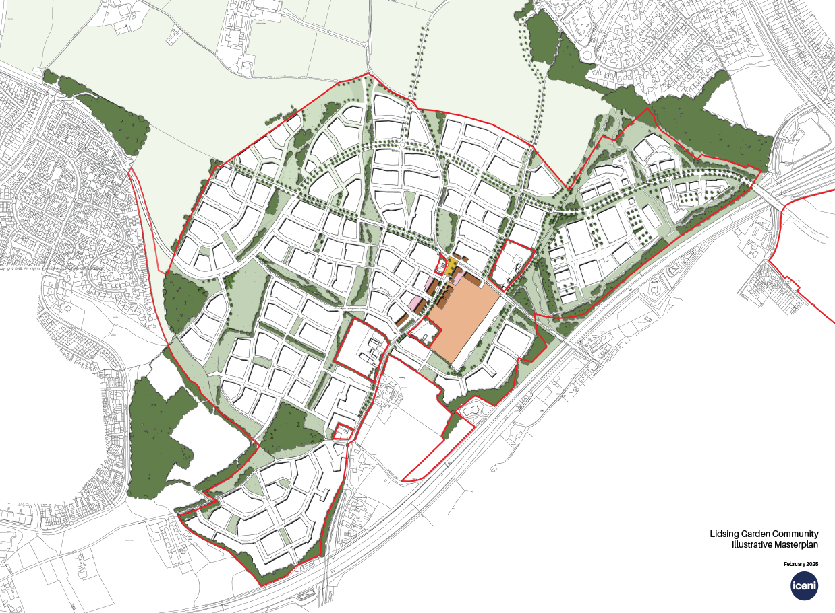
Site Context
All councils plan for growth in their area. MBC allocated the Lidsing site in 2024 for:
Housing - 2,000 dwellings
Jobs – 14 hectares Local centre
M2 connection
New bus services
Opportunity for changes to south – particularly Bredhurst

Slide 3
Timescales
Local Plan covers the period from now to 2038
Subject to planning, first houses in 2028, continuing through to 2042
Development and infrastructure will come forward in phases

Slide 4
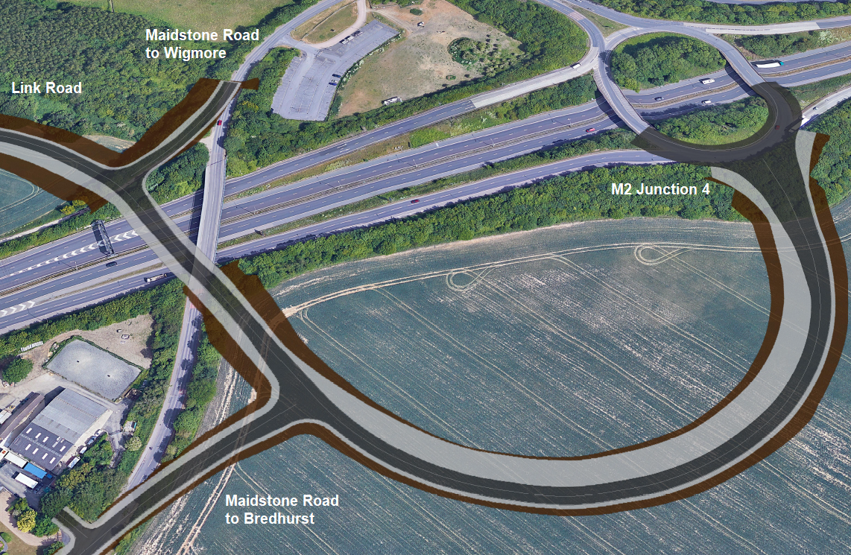
Replacement of Maidstone Road bridge
MBC policy expects the ‘changeover’ between 2033 and 2038
Agreed in principle with National Highways
To Wigmore
Replacement bridge
To Bredhurst

Slide 5
Orbital bus route
Orbital bus route in site policy, taking advantage of the link road
New connections between Lordswood and Hempstead – helping residents access jobs, retail and leisure
Bredhurst residents will be able to walk via Forge Lane to access this route
Chatham station and town centre
Hempstead
Valley
Lidsing housing and employment
Lordswood
Bredhurst
Walk via Forge Lane
Notes:
Bus

Slide 6
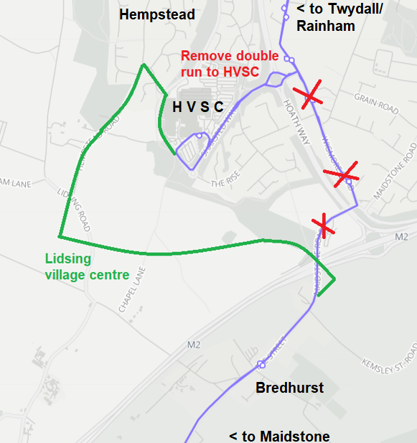
Maidstone bus route
Lidsing development proposes a slight change to bus 130
Would divert from Hempstead Valley via the Lidsing site, but still serve Bredhurst and Boxley
Additional demand could increase the frequency as well
All options allow buses to continue through Bredhurst and Boxley
Notes:
Bus

Slide 7
Bredhurst options for consideration
Forge Lane Bridge Closure
The Street Closure
Dunn Street Closure
Combination - Forge Lane & Dunn Street Road Closure

Slide 8
1. Forge Lane Closure
Indicative traffic closure on Forge Lane
Supports ‘green bridge’ concept in site policy
Allows for active travel (walking, cycling, horse riding) and emergency vehicles
Forge Lane closure – would allow free flowing traffic movement through the village via The Street /Dunn Street

Slide 9
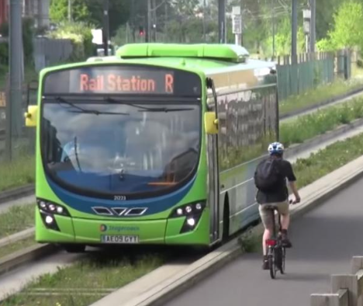
Road
Walking/ cycling links via Chapel Lane to Hempstead Valley
Hempstead
Link Road into Lordswood and Chatham, including orbital bus route
Walking links to Capstone Country Park
Capstone Road
Ham Lane
Hempstead
Walking/ cycling routes enhanced across the area
Access to Wigmore
Link Road
Lordswood
Link Road
Walking/ cycling links to Lordswood and Walderslade
Lidsing Development
Local Centre
Access into Bredhurst
Option 1 – Forge Lane Traffic Closure
Bredhurst
Forge Lane
The Street
Pedestrian/ cyclist priority opportunities
Forge Lane bridge - traffic closure
Lidsing Road to remain a through route but suitably designed so as not to encourage additional traffic
Example green bridge treatment of Forge Lane
Westfield Sole Road
Lidsing Road
Any traffic closures would allow walking, cycling, buses, 999

Slide 10
2. The Street Closure
Indicative traffic closure at north end of Bredhurst
Likely to be north of Kemsley Street Road junction
Allows for active travel, bus routes and emergency vehicles
Access to Bredhurst would be via Dunn Street and Forge Lane. Would slightly deter ‘rat running’

Slide 11
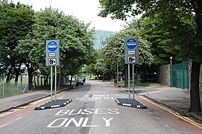
Road
Walking/ cycling links via Chapel Lane to Hempstead Valley
Hempstead
Link Road into Lordswood and Chatham, including orbital bus route
Walking links to Capstone Country Park
Capstone Road
Ham Lane
Hempstead
Walking/ cycling routes enhanced across the area
Link Road
Lordswood
Link Road
Walking/ cycling links to Lordswood and Walderslade
Lidsing Development
Local Centre
Option 2 – The Street Traffic Closure
Bredhurst
The Street
The Street –
traffic closure (north of Kemsley Street Road)
Forge Lane
Lidsing Road to remain a through route but suitably designed so as not to encourage additional traffic
Pedestrian/ cyclist priority opportunities
Any traffic closures would allow walking, cycling, buses, 999
Dunn Street Road
Westfield Sole Road
Lidsing Road

Slide 12
3. Dunn Street Road Closure
Indicative traffic closure at south end of Bredhurst
Location to be confirmed
Allows for active travel, bus routes and emergency vehicles
Access to Bredhurst would be via The Street and Forge Lane. Would not deter ‘rat running’

Slide 13
Road
Walking/ cycling links via Chapel Lane to Hempstead Valley
Hempstead
Link Road into Lordswood and Chatham, including orbital bus route
Walking links to Capstone Country Park
Capstone Road
Ham Lane
Hempstead
Walking/ cycling routes enhanced across the area
Access to Wigmore
Link Road
Lordswood
Link Road
Walking/ cycling links to Lordswood and Walderslade
Lidsing Development
Local Centre
Access into Bredhurst
Option 3 – Dunn Street Road Traffic Closure
Bredhurst
Forge Lane
The Street
Pedestrian/ cyclist priority opportunities
Lidsing Road to remain a through route but suitably designed so as not to encourage additional traffic
Dunn Street Road – traffic closure to the south of Bredhurst
Any traffic closures would allow walking, cycling, buses, 999
Dunn Street Road
Westfield Sole Road
Lidsing Road

Slide 14
4. Forge Lane & Dunn Street Road Closure
Indicative traffic closure at Forge Lane and south end of Bredhurst at Dunn Street Road
Locations of closures to be confirmed
Allows for active travel, bus routes, emergency and farm vehicles
Effectively making Bredhurst a ‘cul-de-sac’.
Allows access to Medway. Access towards Maidstone via new west-east link road.
Would completely stop ‘rat-running’

Slide 15
Road
Chapel Lane
Walking/ cycling links to Hempstead Valley
Hempstead
Link Road into Lordswood and Chatham, including orbital bus route
Walking links to Capstone Country Park
Capstone Road
Ham Lane
Hempstead
Access to Wigmore
Deanwood Drive & Wigmore Road
Walking/ cycling routes enhanced across the area
Link Road
Lordswood
Link Road
Employment Zone
Lidsing Development
The Street
Access into Bredhurst
Walking/ cycling links to Lordswood and Walderslade
Local Centre
Option 4 – Forge Lane & Dunn Street Road Traffic Closure
Bredhurst
Forge Lane
The Street
Forge Lane
Traffic closure
Pedestrian/ cyclist/horse riders
priority opportunities
Lidsing Road to remain a through route but suitably designed so as not to encourage additional traffic
Any traffic closures would allow walking, cycling, buses, 999
Dunn Street Road
Westfield Sole Road
Lidsing Road
Dunn Street Road
Traffic closure to the south of Bredhurst.

Slide 16
Forge Lane & Dunn Street Road Closure
Vehicular access to and from Bredhurst via The Street only
Indicative location of link road and M2J4 access
The Street
Location of closures to be investigated in terms of highway constraints, turning heads to be provided
Active Travel links along new road bridge alignment
Forge Lane
Potential removal of existing traffic calming through the village and improvement to the pedestrian environment
Dunn Street Road

Slide 17
Road Closure Examples
Automatic Number Plate Recognition (ANPR) enforced bus gate
Maintains active travel access throughout or alongside
Limited infrastructure required to the street environment
Allows access for emergency vehicles
Sump breaker bus gate – deters drivers of certain vehicles
Active travel access segregated from the main carriageway
Allows access of larger 999 vehicles

